Slide 1

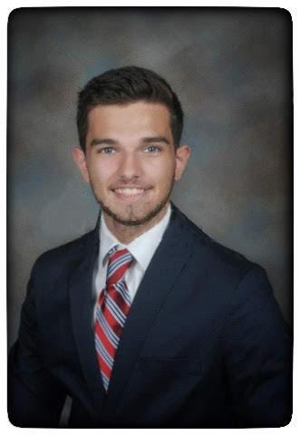
The Cancer Genome Atlas
Kidney Clear Cell Carcinoma
ECE 4783 - Final Presentation
Alex Faché - afache3@gatech.edu, Sam Lovejoy - slovejoy6@gatech.edu
UG 2
Tuesday April 21, 2020
Notes:
0:10 sec

Slide 2
Content
Clinical Problem Statement
Module 1 Recap
Module 2 Recap
Module 3
Literature Review
Supervised Learning Models
Cross-Validation Schemes
Results
Demo
Conclusion and Future Work
References
Appendix
Additional Visualizations
Notes:
In the presentation we will discuss the clinical problem statement driving this project, provide a recap of Modules 1 and 2, and go into detail of Module 3's implementation. The presentation will then conclude with a demo, conclusion, and future work.
0:15 sec

Slide 3
Clinical Problem Statement
to develop a decision support model for diagnosis and prognosis of cancer
follow image processing pipeline for clinical decision making
application needs
early detection
accuracy of cancer subtypes
technical challenges in medical image processing
not enough patient data
difficult to maintain consistent collection process
lighting conditions, stain color
high variation across datasets/hospitals
Notes:
At the beginning of the semester we were given the driving force of medical projects specifically medical image processing: the goal of developing a decision support model for the diagnosis and prognosis of cancer. We follow the image processing pipeline for clinical decision making which consists of image preprocessing, feature extraction and selection, and ultimately prediction modeling.
Some of the needs for an accurate clinical decision support model include: earlier detection of cancer as well more accurate classification of cancer subtypes. Enhancing both of these current issues would help patients receive earlier and more tailored treatment.
However, throwing data into a predictive model is not always straightforward. For instance, some technical challenges include not having enough patient data and the difficulty of collecting data consistently. WIth a lack of big data and high variation among datasets, there is room to improve in clinical decision support.
0:55 sec

Slide 4
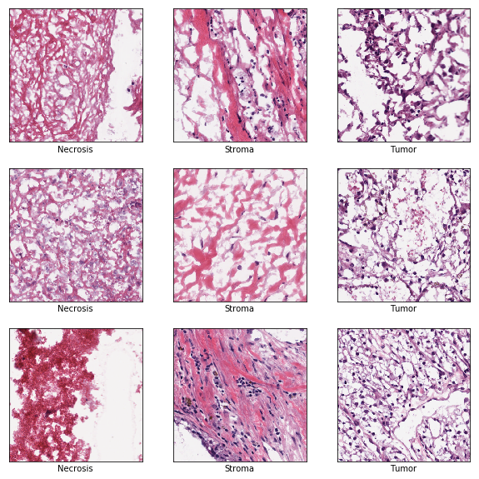
Module 1 - Recap
Initial Dataset
Necrosis, Stroma, Tumor classes
1,000 original whole slide images
20,000 x 40,000 pixels
"quality control"
removal of tissue folding, invalid stains, empty regions of interest
512 x 512 pixel sub-section
Undergraduate Dataset
100 samples of each class
512 x 512 pixels
Sampled images that have undergone "quality control".
Notes:
We begin the technical content of our presentation with a recap of Module 1: Image Preprocessing.
For the undergraduate project, we received quality controlled images consisting of three classes: Necrosis, Stroma, and Tumor. These samples were collected from 1,000 original whole slide images of dimensions 20,000 by 40,000 pixels. For the quality control phase, tissue folding, invalid stains, and empty regions of interest were removed. This resulted in 100 samples of each class with dimensions 512 by 512 pixels.
The image on the right is a snapshot of some of the quality controlled images with Necrosis in the left column, Stroma in the middle column, and Tumor in the right column.
0:15 sec

Slide 5
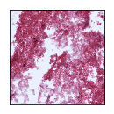
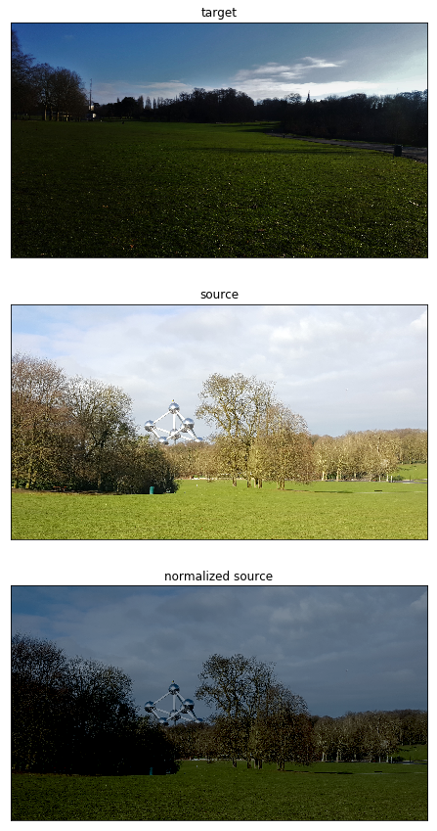
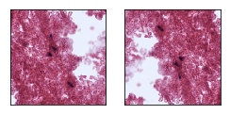
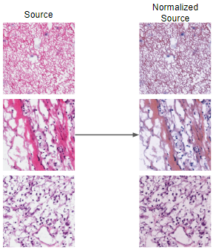
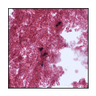
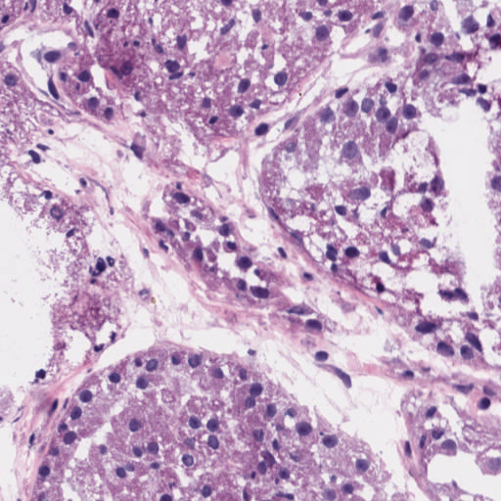
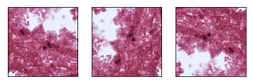
Flowchart
Normalization via Reinhard's Method
CIELAB color space
L* - lightness from black to white
a* - lightness from green to red
b* - lightness from blue to yellow
Data Augmentation
crop
224 x 224 pixels
rotation (CCW)
flip
vertical, horizontal
Necrosis target
90º, 180º, 270º
Notes:
Normalization of the images was conducted using Reinhard's Method which makes use of the CIELAB color space. This color space described the lightness from black to white as L*, lightness from green to red as a*, and lightness from blue to yellow as b*.
In order to verify the correct implementation of the normalization process, a more common image was used as a test: the Atomium in Belgium. We can clearly see that the darker contrast from the top target image is applied to the lighter source image in the middle resulting in the normalized source image in the bottom.
A sample normalization process using Tumor as the source is shown next. It is clear that the heavy shades of purple are applied to the source images.
After normalization, data augmentation aims to increase the number of samples.
As an example, take a sample Necrosis image.
First a 224 by 224 pixel subsection was cropped out.
From there independent vertical and horizontal flips were performed.
Then 3 independent counter-clockwise rotations of 90º, 180º, 270º were performed
This process is repeated for the current sample image then iterated through the entire dataset.
1:05 sec

Slide 6
Module 2 - Recap
feature selection and extraction
Color Based Features | Texture Based Features | Morphological Based Features
RGB LAB HSV min, max, mean, variance, skewness, kurtosis for each channel | GLCM contrast, dissimilarity, homogeneity, ASM, energy, correlation, maxprop Shannon entropy Signal-to-Noise ratio histogram min, max, mean, variance, skewness, kurtosis for GLCM and histogram properties | vertical and horizontal symmetry center of mass percent white and dark pixels number of cells number of corners proportion of edge pixels Matlab regionprops circle radii mean, var, median, mode
Notes:
Module 2 consisted of Feature Selection and Feature Extraction.
The three main categories of features selected were: color, texture and morphological based. The table summarizes these features.
0:15 sec

Slide 7
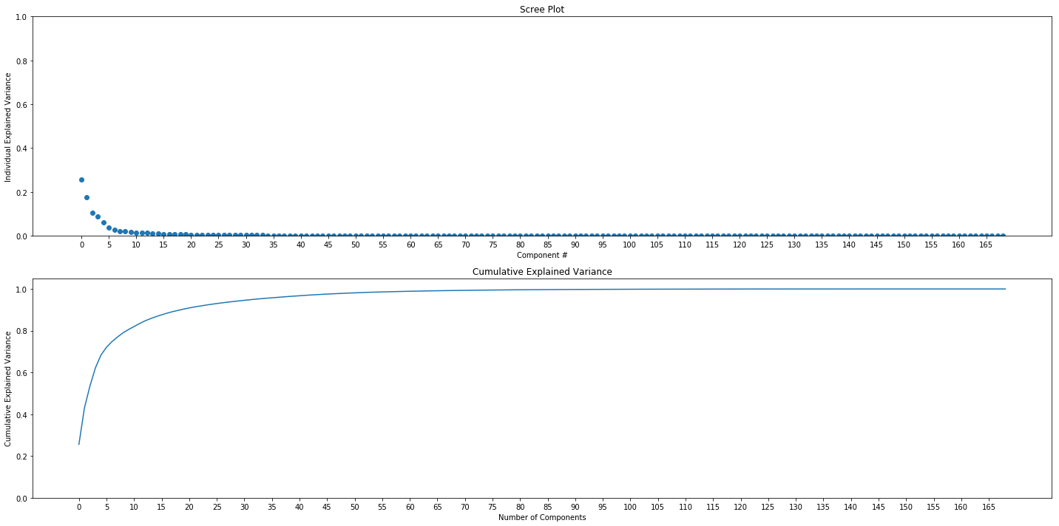
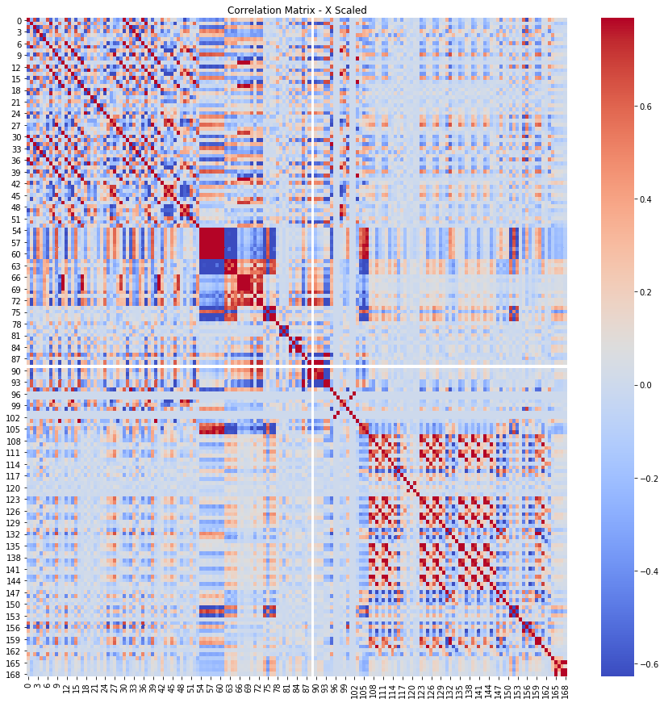
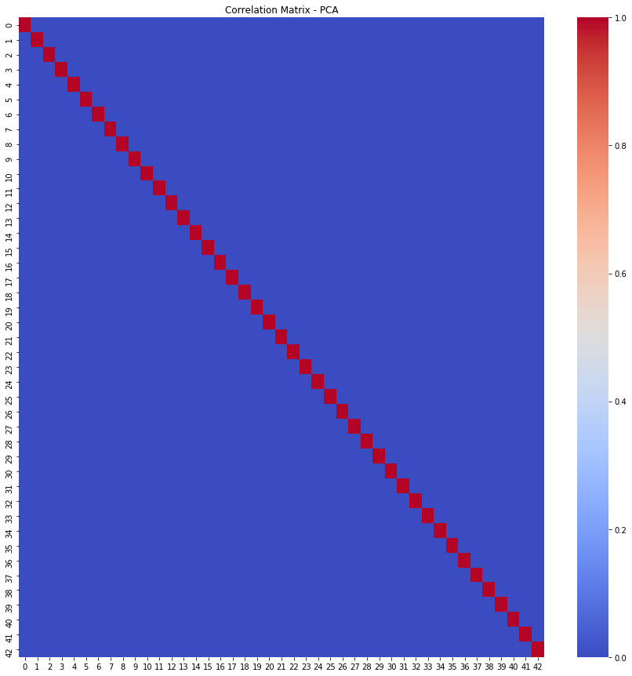
Flowchart*
Feature Selection
literature review
color
texture
morphological
Feature Extraction
function calls to individually implemented feature extractors
Dimensionality Reduction
Principal Component Analysis (PCA)
97% recovered variance → 43 out of 169 principle components
*Appendix - PCA Visualization
Notes:
Through a literature review of image feature selection processes, color, texture, and morphological features were selected.
Upon selection, appropriate Python, Matlab, and handcrafted functions were implemented to extract feature values from an input image.
After computing all features, dimensionality reduction using PCA was applied to reduce the feature space and complexity.
Analyzing the scree plot and cumulative recovered variance of all principal components showed that 97% recovered variance was an appropriate threshold. As a result the top 43 principal components were selected from the original 169 features.
PCA works by selecting principal components in a new feature space that are orthogonal to one another and therefore linearly independent. As a verification of correct implementation, the original features were visualized using a correlation matrix. The different shades of red, white, and blue show some inter dependence.
After dimensionality reduction, a single diagonal red line in a field of blue indicates that all principal components are uncorrelated and the implementation was correct.
1:05 sec

Slide 8
Module 3 - Overview
literature review of supervised learning methods
develop classification models
incorporate cross-validation schemes
analyze using performance metrics
Notes:
Module 3 describes the process of prediction modeling where we use our computed features to predict output labels. The following slides will discuss supervised learning methods, implementation of classification models, cross-validation schemes, and results through performance metrics.
0:15 sec

Slide 9
Literature Review
 | Image Classification using Random Forests and Ferns¹ | Efficient kNN Classification With Different Numbers of Nearest Neighbors² | Speech Emotion Recognition using Support Vector Machine³ | Multiple Sclerosis Detection Based on Biorthogonal Wavelet Transform, RBF Kernel Principal Component Analysis, and Logistic Regression⁴
authors | A. Bosch et al. | S. Zhang et al. | M. Jain et al. | S. Wang et al.
model | random forest, random fern | kNN, kTree, k*Tree | support vector machine | logistic regression
approach | ROI for object detection compare to baseline M-SVM | optimal k for every test sample using decision tree | one-against-all (OAA), gender dependent classification | distinguish between MS or healthy
strengths | faster to train compared to SVM far less computationally expensive | outperformed competing methods in classification accuracy and running cost | uses MFCC and LPCC speech feature extractors | combines biorthogonal wavelet transform, RBF kernel PCA, and logistic regression greater sensitivity, accuracy
limitations | performance is slightly lower than benchmark M-SVM |  | high variance in speech recording quality
Notes:
The paper Image Classification using Random Forests and Ferns considers the image classification problem using the Caltech-101 and 256 image datasets.
They intend to compare the performance of random forests and random ferns to a benchmark multi-way SVM.
The reason for selecting a random forest and fern is that it is faster to train compared to a SVM.
For the object detection process, they employ a strategy using a learned region of interest to eliminate regions of high visual similarity corresponding to the background.
Compared to a multi-way SVM, a random forest performed 80.0% vs 81.3% on the Caltech-101 dataset however it had a classification time that was 40 times quicker.
The paper demonstrated that using random forests and ferns reduces training and testing costs significantly compared toa multi-way SVM, and has comparable performance.
The paper Efficient kNN Classification With Different Numbers of Nearest Neighbors uses a pairing of KNN and Decision Trees for a more optimal way of determining the number of neighbors for each test sample.
Instead of class labels as the leaves of the decision tree, values of k are used instead.
The paper Speech Emotion Recognition using Support Vector Machine aims to classify emotions through speech using Support Vector Machine.
Use MFCC (Mel-frequency cepstrum) and LPCC (Linear Prediction Cepstral Coefficients) algorithms.
Using a trained actors, noiseless environment (LDC) and a student, noisy environment (UGA) speech datasets, they showed that using gender dependent classification was more accurate than one-against-all methods.
The paper Multiple Sclerosis Detection Based on Biorthogonal Wavelet Transform, RBF Kernel Principal Component Analysis, and Logistic Regression uses MRI data to distinguish between multiple sclerosis and healthy patients using a combination of biorthogonal wavelet transform, RBF kernel PCA, and logistic regression.
The combined method had a greater sensitivity and accuracy than 5 state-of-the-art approaches.
0:45 sec

Slide 10
Flowchart*
Data
X (26700 x 43)
y (26700 x 1)
Split Data into Training and Testing Sets
0.70 - 0.30
Cross-Validation
test effectiveness of the model
K-Fold
Shuffle-Split
Select Models
KNN
SVM
Random Forest
Training set
X_train (18690 x 43)
y_train (18690 x 1)
Performance Metrics
evaluate and verify model performance
Confusion Matrix
Accuracy Score
F1-Score
Matthews Correlation Coefficient
Area Under the Curve
Hyperparameter Optimization
determine most effective hyperparameters
GridSearchCV
Test
X_test (8010 x 43)
y_test (8010 x 1)
*Appendix - Performance Metrics
Notes:
The process of training supervised learning models is described by the following block diagram. The dataset is comprised of 26,700 samples each with 43 features extracted from PCA. The labels are the set of values 0, 1, and 2 corresponding to Necrosis, Stroma, and Tumor classes, respectively.
The dataset is then split 70-30 train-test.
Supervised learning methods K-NearestNeighbors, Support Vector Machine, and Random Forest are selected for implementation.
Several cross-validation schemes including K-Fold and Shuffle-Split will be used to test the effectiveness of each model.
GridSearchCV is an exhaustive hyperparameter tuning method and will be used to determine the optimal parameters of each model.
Finally, performance on the test set will be measured with several metrics.
0:45 sec

Slide 11
K-Nearest Neighbors
Two classes: red, blue
K = 4
New sample: green
K = number of neighbors
distance
p = 2 (euclidean distance)
get distance from every datapoint to current sample
sort in descending order
take the top K nearest labels
class label for new data points is the mode of this subset
3 : 1
Notes:
K-Nearest Neighbors is a local classification method in that it only uses several training samples to determine the final prediction. The K stands for the number of these training samples, also known as neighbors, that will be used. The algorithm works by determining the distance from a test data point to every data point in the training set. These distances are sorted in ascending order and the top K are selected. The resulting class label of the test data point is the mode of the selected subset.
As an example, let's say we are given two classes red and blue and a green test data point.
With K equal to 4, a circle bounds the four nearest neighbors based on euclidean distance.
It is clear that there are 3 blue and 1 red label therefore classifying our green test data point as blue.
0:30 sec

Slide 12
Support Vector Machine
maximize the margin of the decision boundary
only works for linearly separable data
else use Soft SVM, Kernel
support vectors define the boundary
correct classification when
y_{i} * (x_{i}*Θ + b) ≥ 0
given constrained optimization → lagrangian multiplier
y_{i} * (x_{i}*Θ + b) ≥ 1
|y_{i}| = 1
|x_{i}*Θ + b| ≥ 1
optimization makes use of Karush-Kuhn-Tucker (KKT) condition for an inequality constraint
solve constraint with quadratic programming → margin
Soft SVM
Kernel
Label -1
Label 1
Notes:
In order to create an effective decision boundary for classification, there needs to be a large enough cushion between classes such that it is robust and generalizable. Support Vector Machine provides a template to increase the decision boundary's margin
Because SVM creates a concrete decision boundary that only works for linearly separable data, methods such as Soft SVM and Kernels can be used for nonlinearly separable data.
This decision boundary is created with the help of support vectors. In determining these support vectors, the highlighted constraint must be solved. Because the problem is setup as a constrained optimization with respect to theta and b, a lagrangian multiplier is used. On top of this, because it is an inequality constraint and not a standard equality constraint, KKT is used. Solving the constraint using a quadratic programming package returns the initial lagrangian multiplier which in turn dictates the support vectors.
A poor example of a decision boundary is shown on the right as it has a very small margin. After applying SVM, new support vectors are determined and a better boundary is selected.
0:35 sec

Slide 13
Random Forest = Bagged Random Decision Trees*
Entropy
M classes
H = -𝚺{P_{i} * log₂ P_{i}}|_{i=1:M}
Information Gain
IG = H - (H_{L} * P_{L} + H_{R} * P_{R})
Decision Tree
split dataset recursively based on feature and feature value with highest information gain
create subsets until leaf nodes represent prediction of class label
Bagging - Bootstrap Aggregating
train classifier on subset of training set
final classifier uses all sub classifiers to make final prediction
B classifiers
f(x) = majority{f_{j}(x)}|_{j=1:B}
*Appendix - Random Forest Example
Notes:
Random Forests are described as Bagged Random Decision Trees. This is because, as a forest implies, multiple decision tree classifiers are collected together as one overall classifier. The bagged randomness comes from an implementation detail where only a random subset of features are used to train each decision tree.
Entropy and information gain are the governing principles of decision trees. Entropy can be described as uncertainty in a prediction and is ideally close to 0. Information gain can be viewed as a change in entropy. Therefore with a greater information gain, more uncertainty is removed.
A decision tree works by recursively splitting the training set along a single feature that results in the greatest information gain. Splits continue to happen until a subset of the training set can be classified as a single class resulting in the creation of a leaf node.
Bagging in random forests is simply the process of training B different decision trees. The final prediction is then a majority voting scheme among all classifiers on a test data point.
1:10 sec

Slide 14
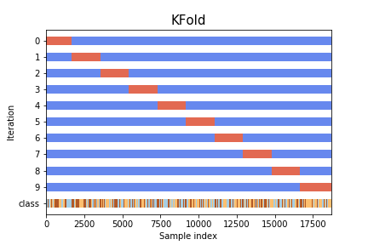
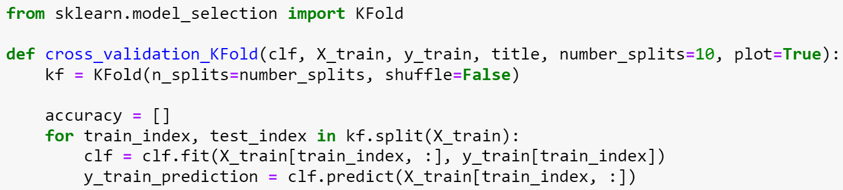
Cross-Validation Schemes - K-Fold*
test the effectiveness of a ML model before hyperparameter optimization and training
split dataset into K subsets
each subset is iteratively used as test set
estimator is trained on other K-1 subsections
estimator is tested on kth subset
accuracy score is recorded
Sample indices. Train, Test.
*Appendix - K-Fold
Notes:
Before training each model, it is tested internally using cross-validation schemes. These schemes are used to test the effectiveness of the model before hyperparameter tuning in order to determine if it is a model worth further consideration.
K-Fold performs K iterations of the model on the training set. In doing so, 1 of the K training sections is used as an intermediate test set. As shown in the graphic, for each iteration a different subset is used as the training set.
0:30 sec

Slide 15
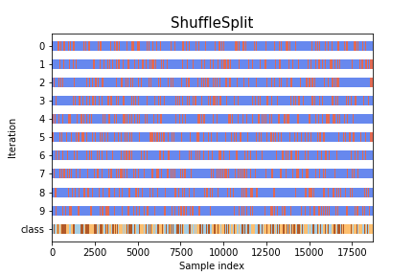
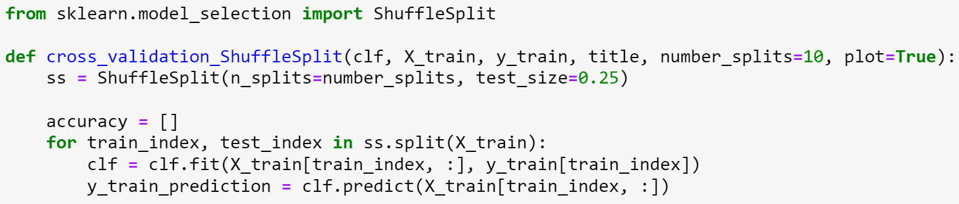
Cross-Validation Schemes - Shuffle Split*
select random indices of training set
Sample indices. Train, Test.
*Appendix - Shuffle Split
Notes:
Shuffle Split performs K iterations of the model on the training set. In doing so, a random selection of training indices are used as an intermediate test set. As shown in the graphic, for each iteration a different subset is randomly.
0:15 sec

Slide 16
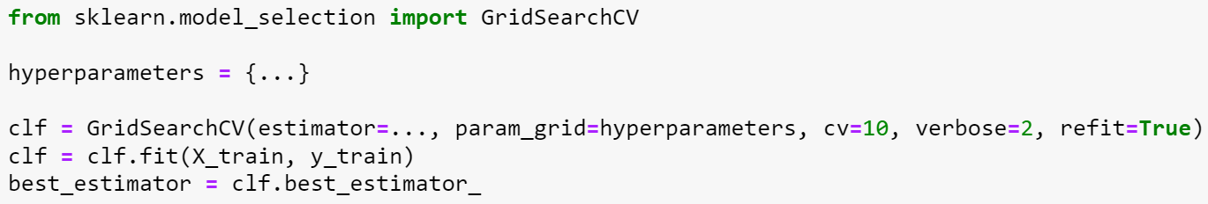
Hyperparameter Tuning
Exhaustive Grid Search
generates estimators from given hyperparameter list
returns estimator with highest score
KNN | SVM | Random Forest
n_neighbors: number of neighbors to use | C: regularization parameter | max_depth: maximum depth of the tree
p: power parameter for the Minkowski metric | 𝛾: kernel coefficient for radial basis function | min_samples_leaf: minimum number of samples required to split an internal node
Notes:
After cross-validation schemes have been applied to a bare bones model and it proves to be effective, its parameters are optimized. An exhaustive grid search on input parameters returns the estimator with the highest score. The code snippet on the right shows such a function call.
For KNN, SVM, and Random Forest, some hyperparameters are listed in the table.
0:20 sec

Slide 17
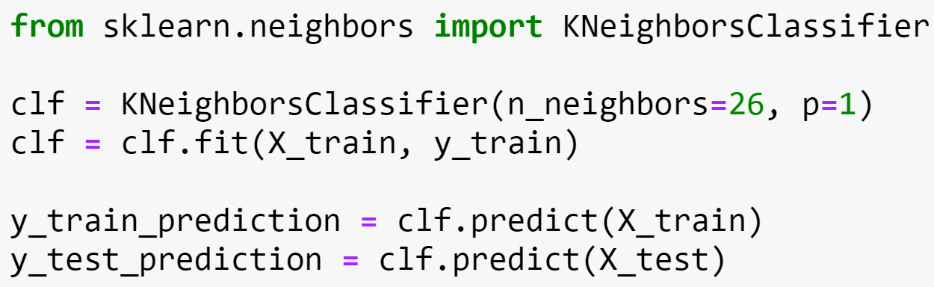
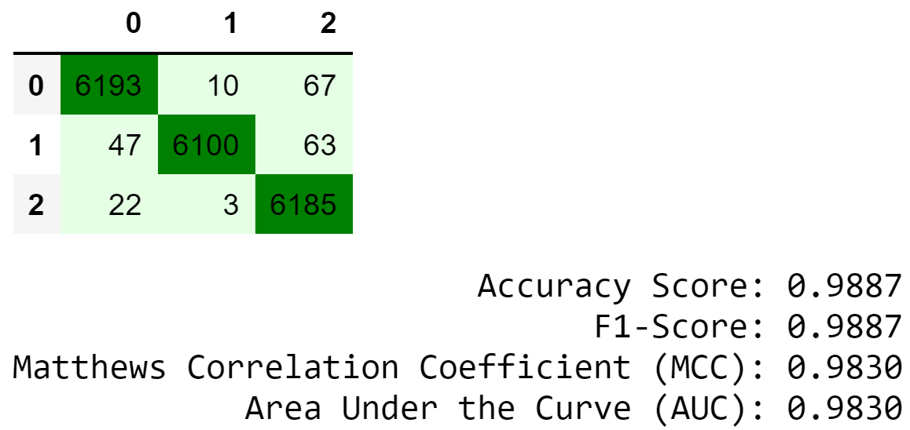
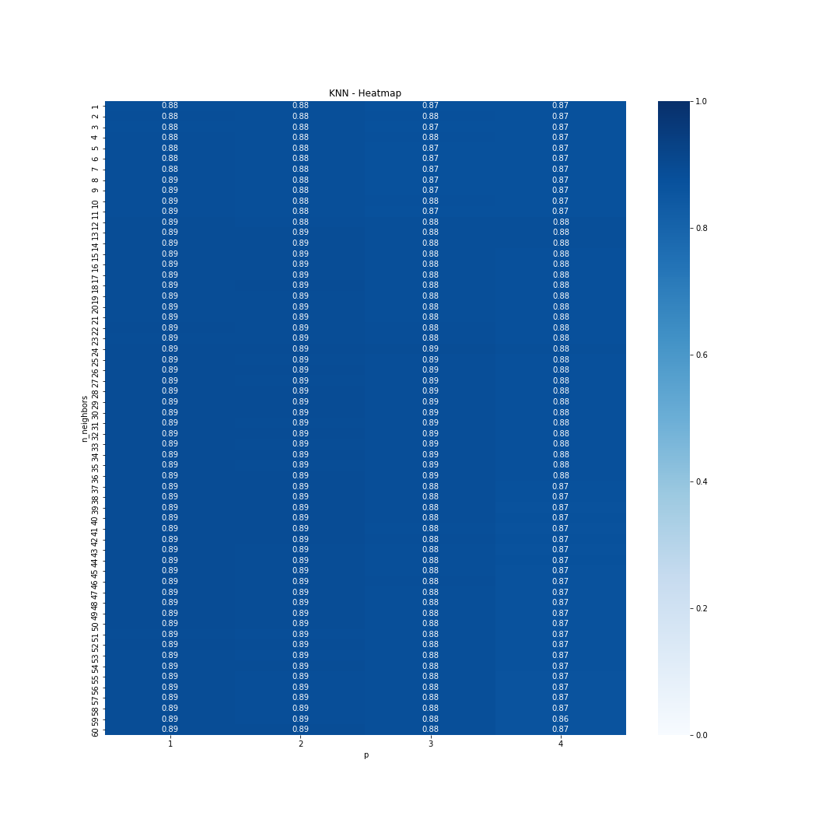
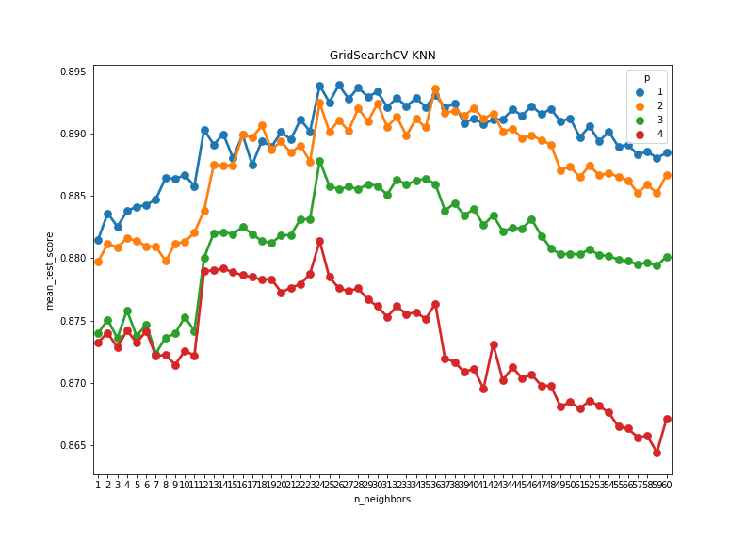
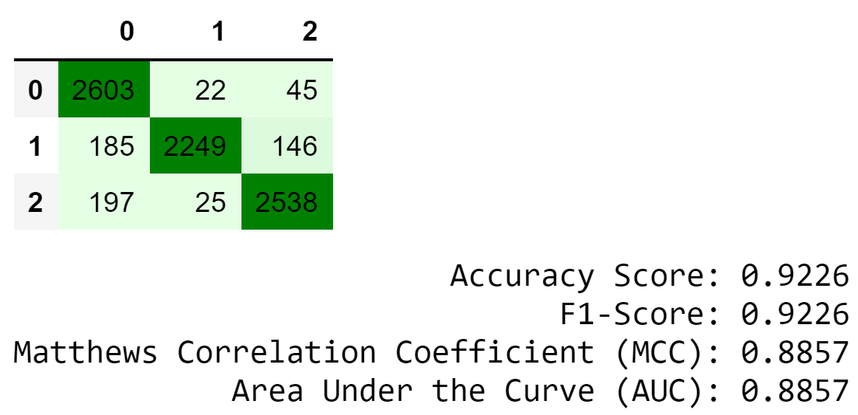
Results - K-Nearest Neighbor
Training Set
Testing Set
*Appendix - Decision Boundary Visualization
Notes:
For KNN, grid search was used for hyperparameter optimization. Corresponding heat map and plot shows that number of neighbors of 26 and Minkowski distance p of 1 are within the stable plateau region. Using these parameters, the training set performed very well reaching nearly 99% accuracy along with a 92% test set accuracy.
0:15 sec

Slide 18
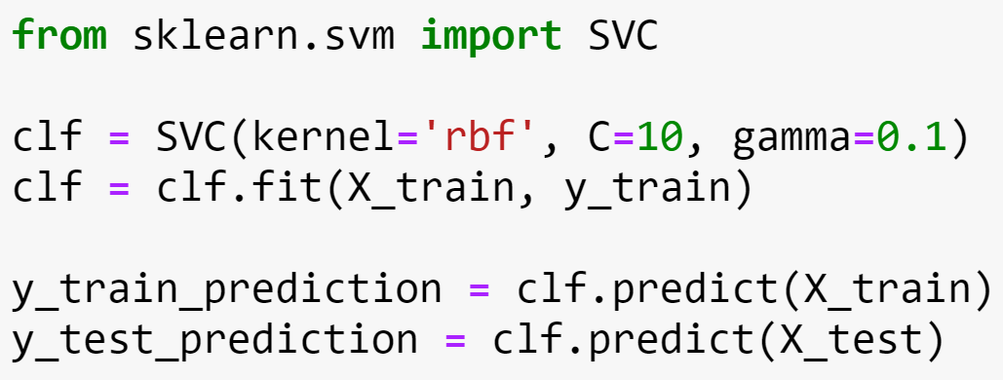
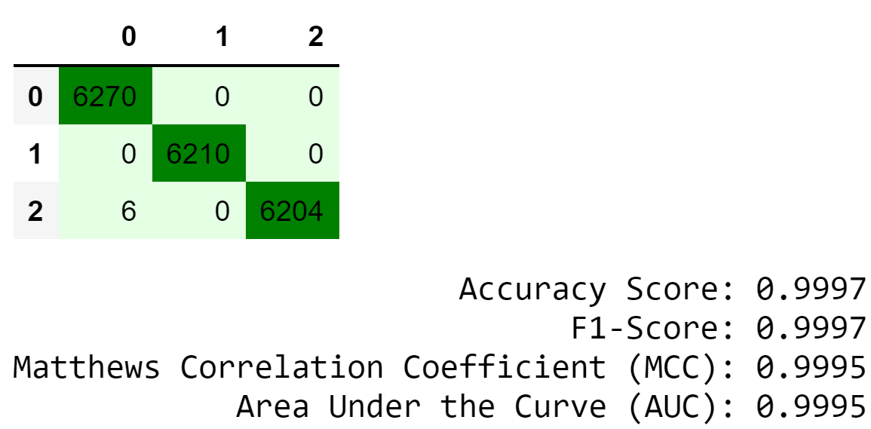
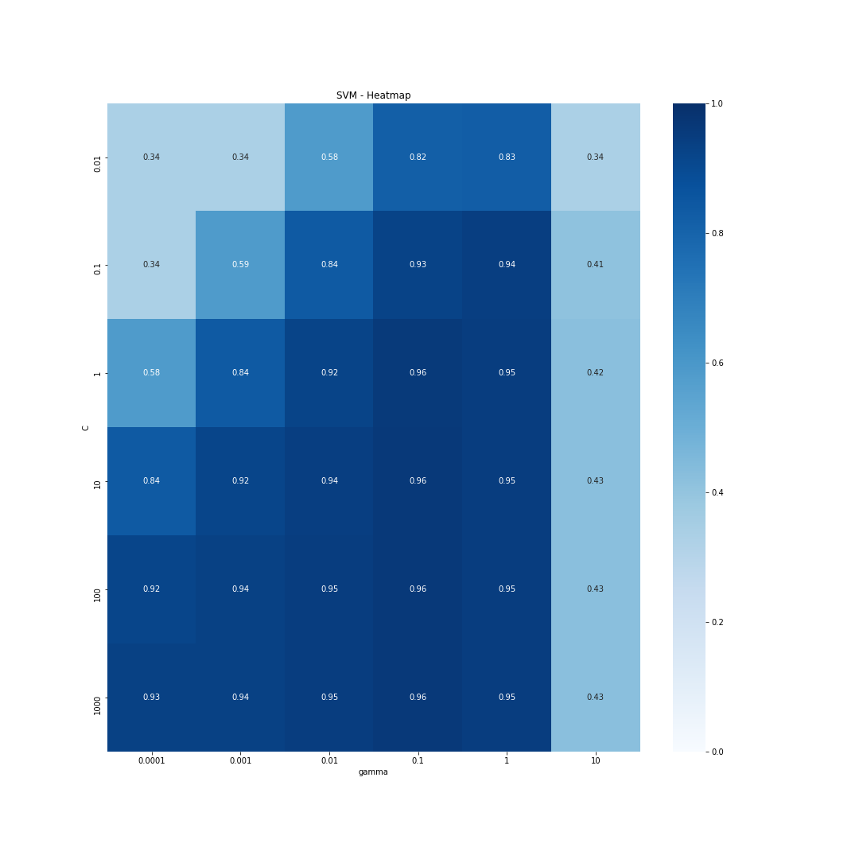
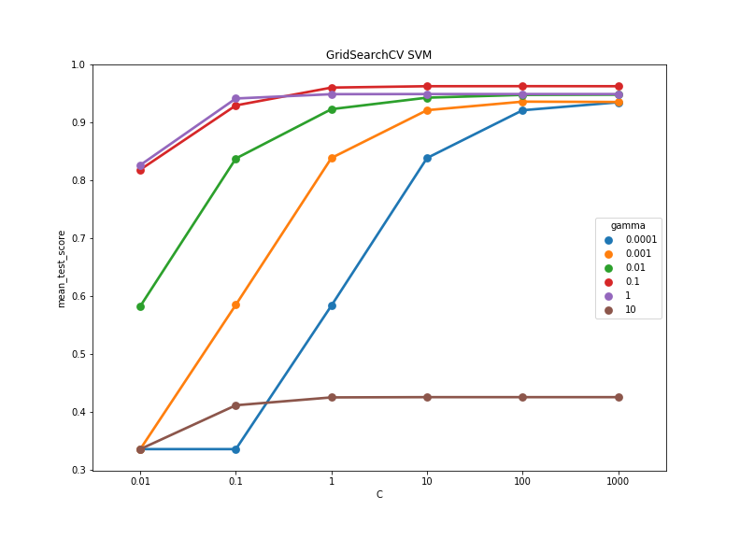

Results - Support Vector Machine
Training Set
Testing Set
Notes:
For SVM, grid search was used for hyperparameter optimization. Corresponding heat map and plot shows that a regularization parameter C of 10 and kernel coefficient gamma of 0.1 are within the stable plateau region. Using these parameters, the training set performed very well reaching nearly 100% accuracy along with a 97% test set accuracy.
0:15 sec

Slide 19
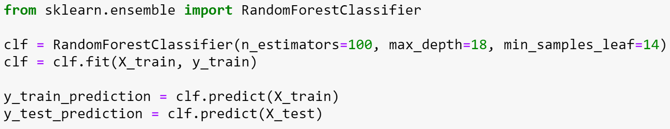

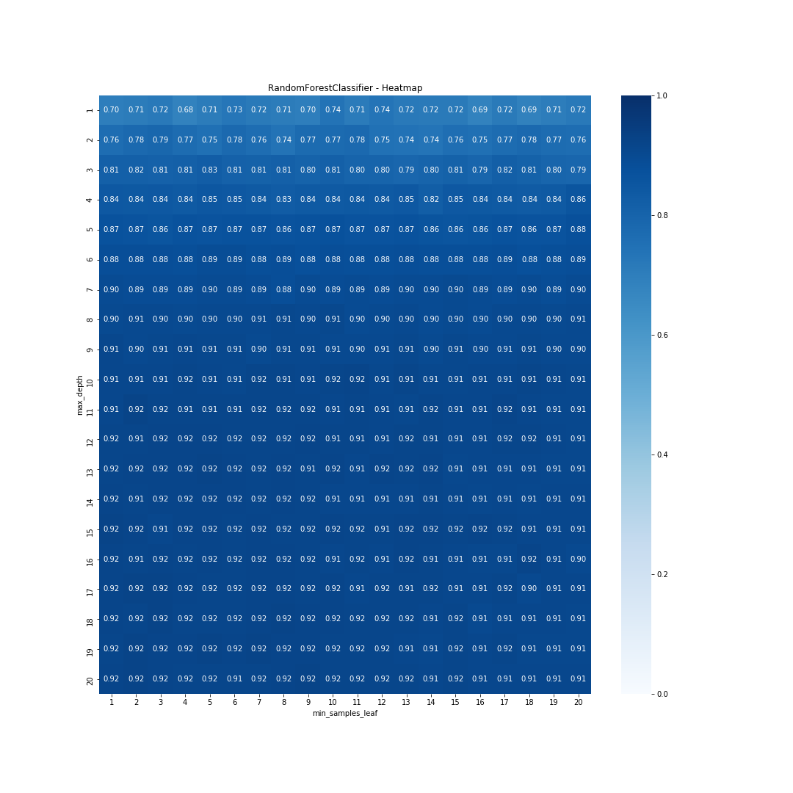
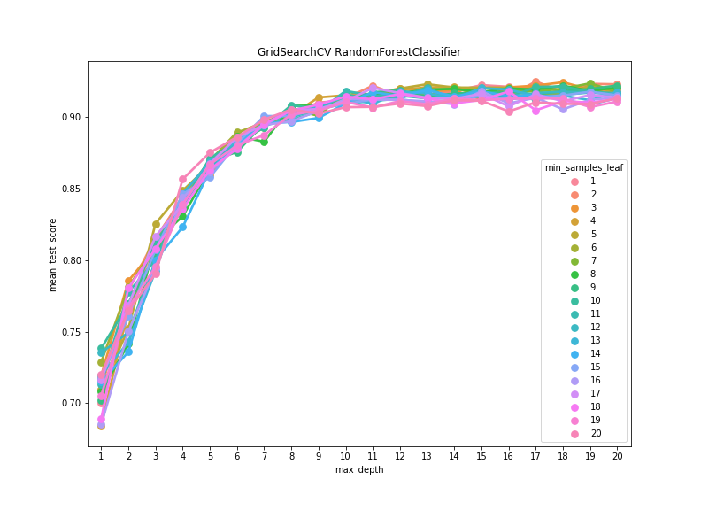
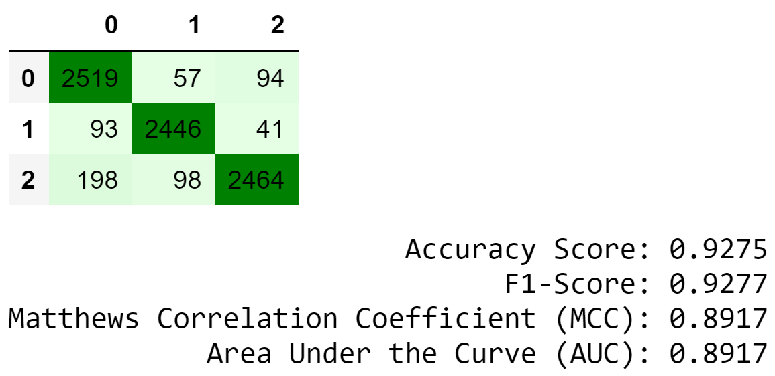
Results - Random Forest*
Training Set
Testing Set
Notes:
For Random Forest, grid search was used for hyperparameter optimization. Corresponding heat map and plot shows that a maximum depth of 18 and minimum number of samples per leaf of 14 are within the stable plateau region. Using these parameters, the training set performed very well reaching nearly 100% accuracy along with a 92% test set accuracy.
0:15 sec

Slide 20
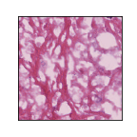
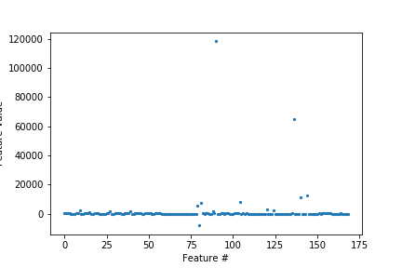
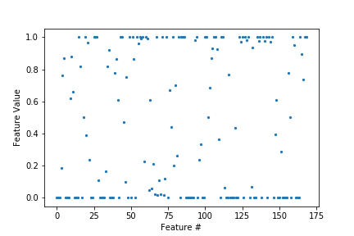
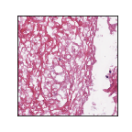
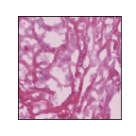
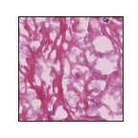
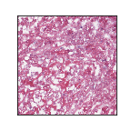
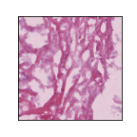
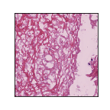
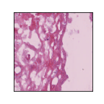
Demo
169 original features of top subsection
169 scaled features of top subsection.
Test Image
Pass through PCA to reduce to 43 principle components.
Input features into KNN, SVM, and Random Forest classifiers.
Target Image
 | Subsection 1 | Subsection 2 | Subsection 3 | Subsection 4 | Subsection 5
KNN
SVM
Random Forest
Normalized Image
select a random test image (show)
crop a subsection of it (show)
run feature extractor (show plot)
MinMaxScaler (show plot)
use original PCA model to fit test image
todo run and save this model
apply prediction with KNN, …
show results
Subsections
Notes:
An example of the entire process is captured through this flowchart.
First a test image is selected. This one is of the Necrosis class.
Then it is normalized using a target image.
Five subsections are created from the normalized image.
The original 169 features extracted are visualized. These features are then normalized and pass through PCA to only include the top 43 principle components.
As summarized in the table, each green box represents a correct classification and each red box indicates a misclassification. For this particular test data point, all subsections were correctly classified by KNN, 3 out of 5 by SVM, and 4 out of 5 by Random Forest.
0:45 sec

Slide 21
Conclusion and Future Work
Hyperparameter Tuning
KNN was the simplest with only 1 true parameter
Training time
KNN and Random Forest were more efficient
Accuracy
SVM was slightly more accurate than KNN and Random Forest
Ensemble learning
combine KNN, SVM, Random Forest, etc
CNN
feature extraction
prediction
Metric (test set) | KNN | SVM | Random Forest
Accuracy | 0.9226 | 0.9652 | 0.9220
F1-Score | 0.9226 | 0.9653 | 0.9222
MCC | 0.8857 | 0.9480 | 0.8838
AUC | 0.8857 | 0.9480 | 0.8838
Notes:
All three methods tested showed great promise on this small data set. Within the three methods, the process of tuning KNN's hyperparameters was the simplest since it really only had 1 parameter that needed to be optimized. Additionally, KNN and Random Forest were computationally much more friendly than SVM. However, SVM did have the best test results. For all three methods, testing set metrics performed 4-8% below their training counterparts, indicating some overfitting may have occurred.
Using this project as a stepping stone I would like to look into ensemble learning where different classifiers are added together similar to a Random Forest. Additionally using a convolutional neural network for feature extraction or prediction could be very revealing.
0:45 sec

Slide 22
References
A. Bosch, A. Zisserman and X. Munoz, "Image Classification using Random Forests and Ferns," 2007 IEEE 11th International Conference on Computer Vision, Rio de Janeiro, 2007, pp. 1-8.
S. Zhang, X. Li, M. Zong, X. Zhu and R. Wang, "Efficient kNN Classification With Different Numbers of Nearest Neighbors," in IEEE Transactions on Neural Networks and Learning Systems, vol. 29, no. 5, pp. 1774-1785, May 2018.
Manas Jain, Shruthi Narayan, Pratibha Balaji, Bharath K P, Abhijit Bhowmick, Karthik R, "Speech Emotion Recognition using Support Vector Machine," 2020, [http://arxiv.org/abs/2002.07590 arXiv:2002.07590].
S. Wang et al., "Multiple Sclerosis Detection Based on Biorthogonal Wavelet Transform, RBF Kernel Principal Component Analysis, and Logistic Regression," in IEEE Access, vol. 4, pp. 7567-7576, 2016.

Slide 23
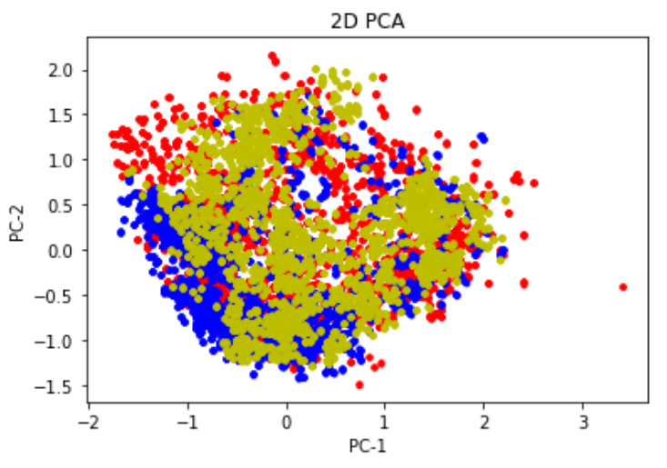
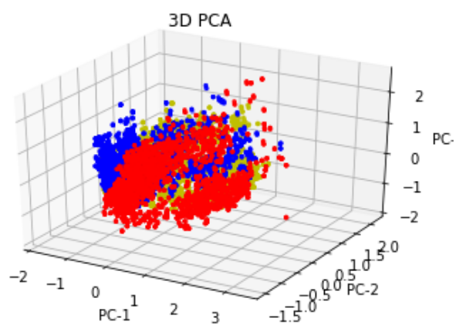
Appendix - PCA Visualization
Necrosis, Stroma, Tumor

Slide 24
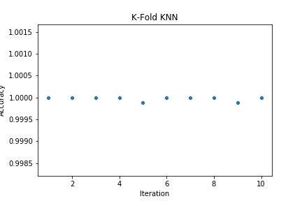
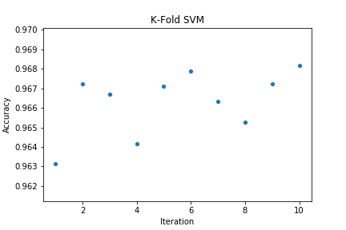
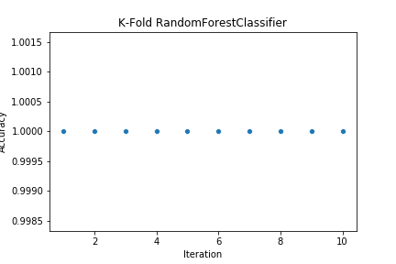
Appendix - K-Fold

Slide 25
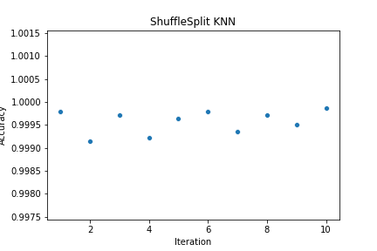
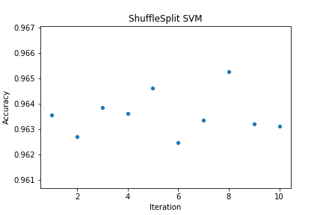
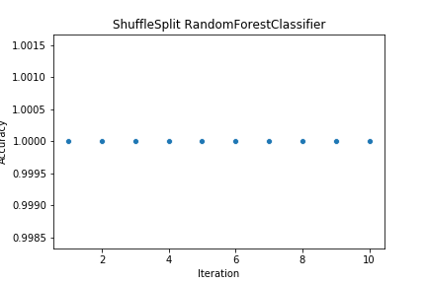
Appendix - Shuffle Split

Slide 26
Appendix - Performance Metrics
Confusion Matrix | Accuracy Score | F1-Score | Matthews Correlation Coefficient | Area Under the Curve
Summary of prediction results among each class for a classification problem. | Fraction of correctly classified labels. | F1 = 2*(precision*recall) / (precision + recall) | Balanced measure taking into account TP, TN, FP, FN. | Trapezoidal rule. TPR vs FPR
Return Values
Confusion matrix C_{ij.} Observations in group i and predicted in group j. | [0, 1] 0: worst accuracy 1: best accuracy | [0, 1] 0: worst precision and worst recall 1: best precision and best recall | [-1, +1] -1: inverse prediction 0: random prediction +1: perfect prediction | [0, 1] 0: worst performance 1: perfect performance
Notes:
In order to assess each supervised learning model, a set of performance metrics will be used. These are confusion matrix, accuracy score, F1-score, matthews correlation coefficient, and area under the curve.
The first is a confusion matrix which summarizes prediction results from all classes. It return a matrix showing the number of correct classifications and number of misclassifications.
The accuracy score is the fraction of correctly classified labels.
F1-Score is the weighted average between precision and recall. As a result, it captures both accuracy and number of correctly predicted labels.
Matthews Correlation Coefficient is thought of as a balanced metric taking into account TP, TN, FP, and FN.
Area Under the Curve is a ratio between true positive rate and false positive rate.
0:45 sec
Precision
TP / (TP + FP)
Recall
TP / (TP + FN)
TPR - true positive rate = recall = sensitivity
TP / (TP + FN)
correctly identified instances
FPR - false positive rate = 1 - recall = 1 - specificity
FP / (FP + TN)
misclassified instances

Slide 27
Appendix - Random Forest Example
Initial H = 0.99
feature x_{j}
feature x_{j}
feature x_{i}
feature x_{i}
H_{L} = 0.97
H_{R} = 1.0
H_{L} = 0.81
H_{R} = 0.72
IG₁ = 0.01
IG₂ = 0.23
Select right path (IG₂ > IG₁) with feature x_{i} and the value of the vertical line to use for current split.

Slide 28
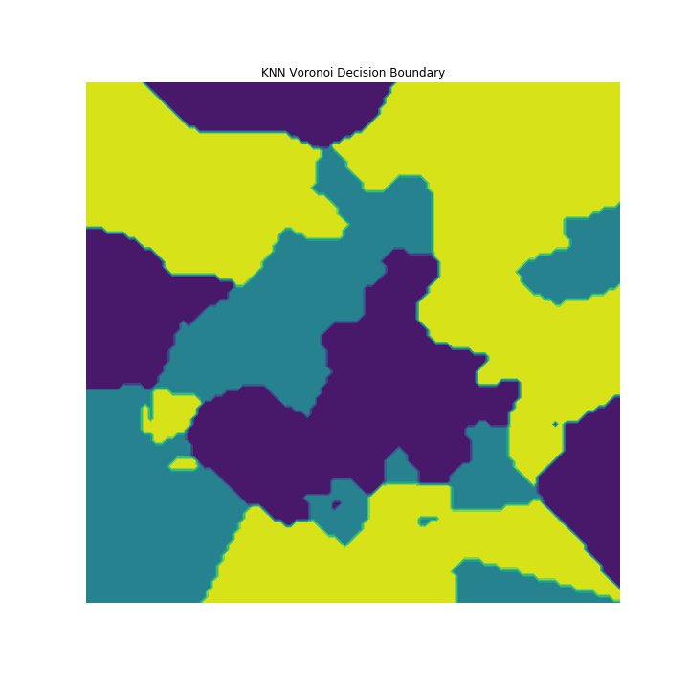
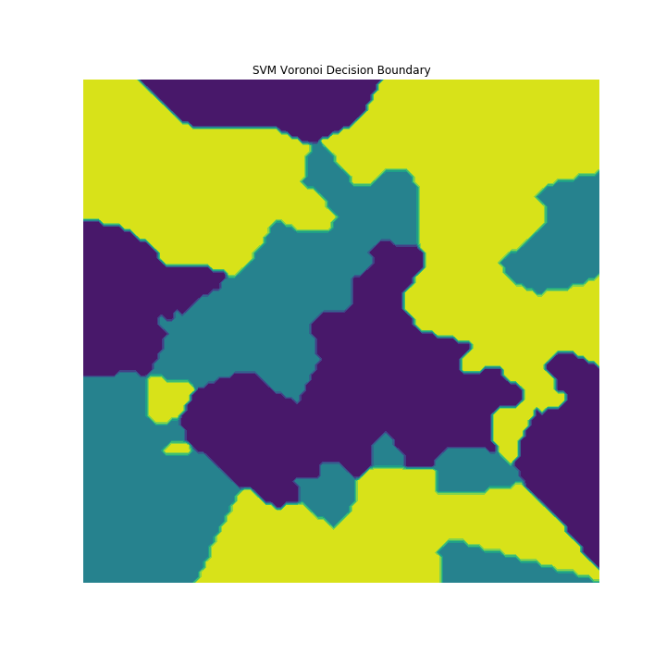

Appendix - Decision Boundary Visualization
t-SNE is used to visualize high dimensional data and decision boundaries. Voronoi decision boundaries for KNN, SVM, and Random Forest are shown. Due to computation constraints, a subset of the training set was used for this visualization.

